Slide 1
LECTURE: 7
Search Strategies

Slide 2

A* Search
A* combines actual and heuristic costs
f(n) = g(n) + h(n)
Prioritizes nodes with lowest total cost.
Balances exploration and exploitation effectively.
Eg: gaming, logistics, network routing

Slide 3
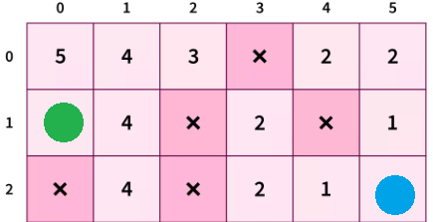
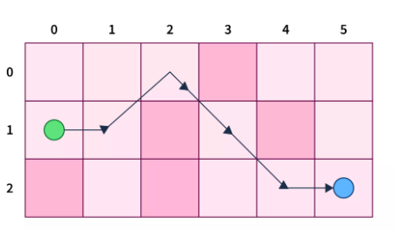
Working of A* Search
Start at source node, initialize lists.
Select node with lowest f(n)
If node is goal, return success.
Generate valid child nodes, add open.
Move selected node to closed list.
Repeat until goal is reached or failure

Slide 4
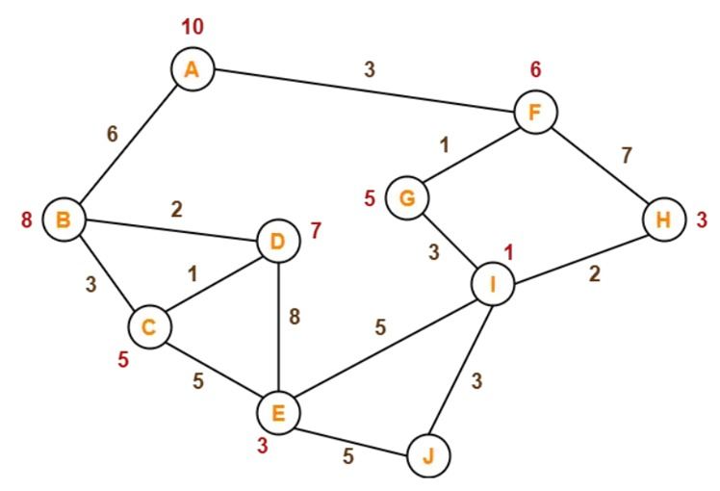
Problem Practice:
    Find the path from A to J

Slide 5
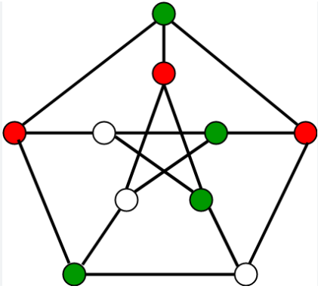
Constraint Satisfaction Problem(CSP)
CSPs involve variables, domains, and constraints.
Variables must be assigned values from domains.
Constraints define valid combinations of values.
Used in puzzle-solving and scheduling problems.
Provides structured framework for problem-solving.
Eg: Sudoku, map coloring, job scheduling

Slide 6
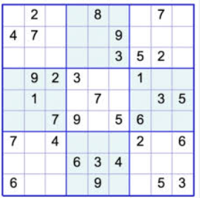
Working of Constraint Satisfaction Problem(CSP)
Define variables, domains, and constraints clearly.
Assign values to variables incrementally.
Check constraints for every assignment made.
Backtrack if constraints are violated.
Continue until all constraints are satisfied.
Return solution or failure if unsolvable

Slide 7
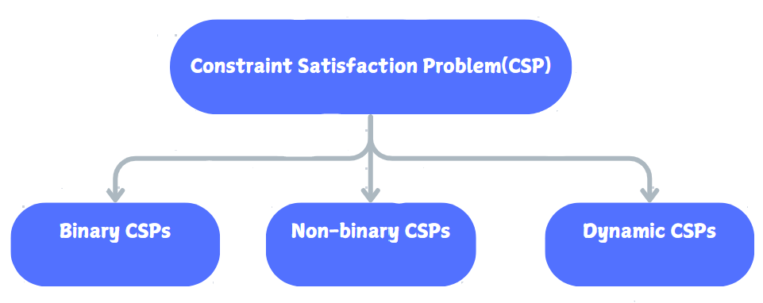
Types of Constraint Satisfaction Problem(CSP)

Slide 8
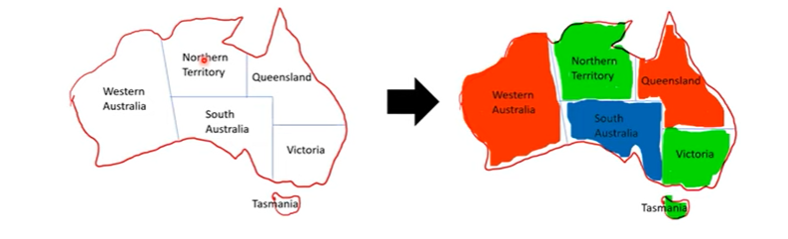
Binary Constraint Satisfaction Problems(CSPs)
Binary CSPs involve constraints between pairs.
Each constraint connects exactly two variables.
Nodes represent regions; edges are constraints.
No two connected nodes share values.
Easier to visualize and solve problems.
Example: Map coloring with neighboring regions

Slide 9
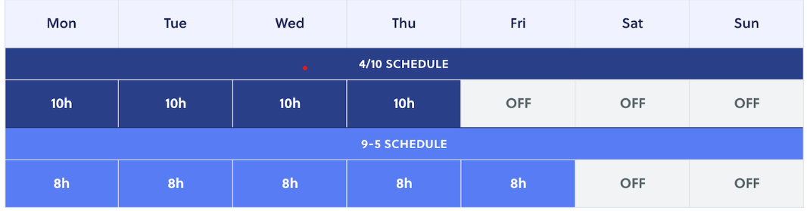
Non-Binary Constraint Satisfaction Problems(CSPs)
Non-binary CSPs involve multi-variable constraints.
Constraints apply to three or more variables
More complex than binary CSPs overall.
Often decomposed into binary subproblems.
Specialized algorithms handle higher-order constraints.
Example: Scheduling tasks in distinct times.

Slide 10
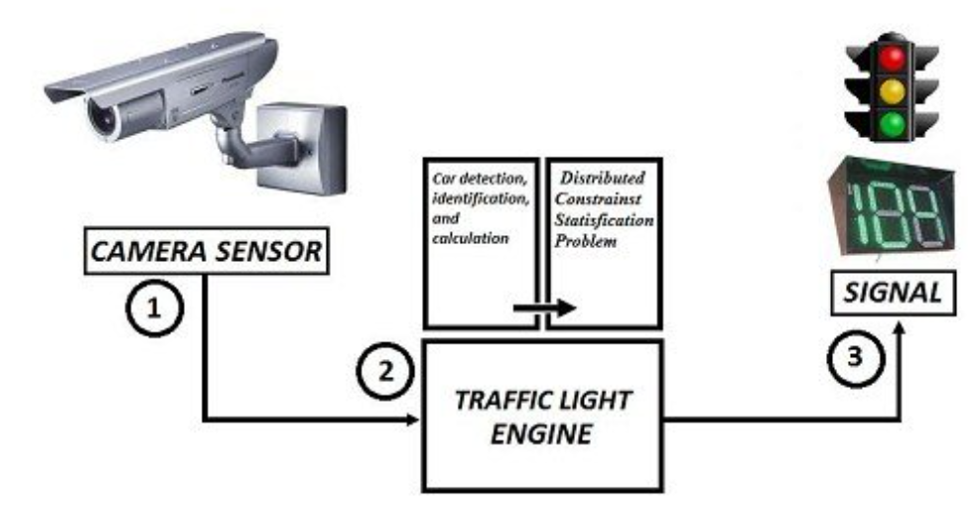
Dynamic Constraint Satisfaction Problems(CSPs)
Dynamic CSPs change variables or constraints.
Require adaptive algorithms for real-time updates.
Continuously update and reevaluate solution space.
More flexible but computationally challenging problems.
Used in dynamic, unpredictable environments effectively.
Example: Real-time scheduling with resource changes.

Slide 11
NEXT: Decoding Knowledge: Mapping facts to symbols!

